Slide 1
Here are some of our favourite recipes, we hope you enjoy! Love, Sarah x
We are a very friendly bunch, join our mailing list here

Slide 2
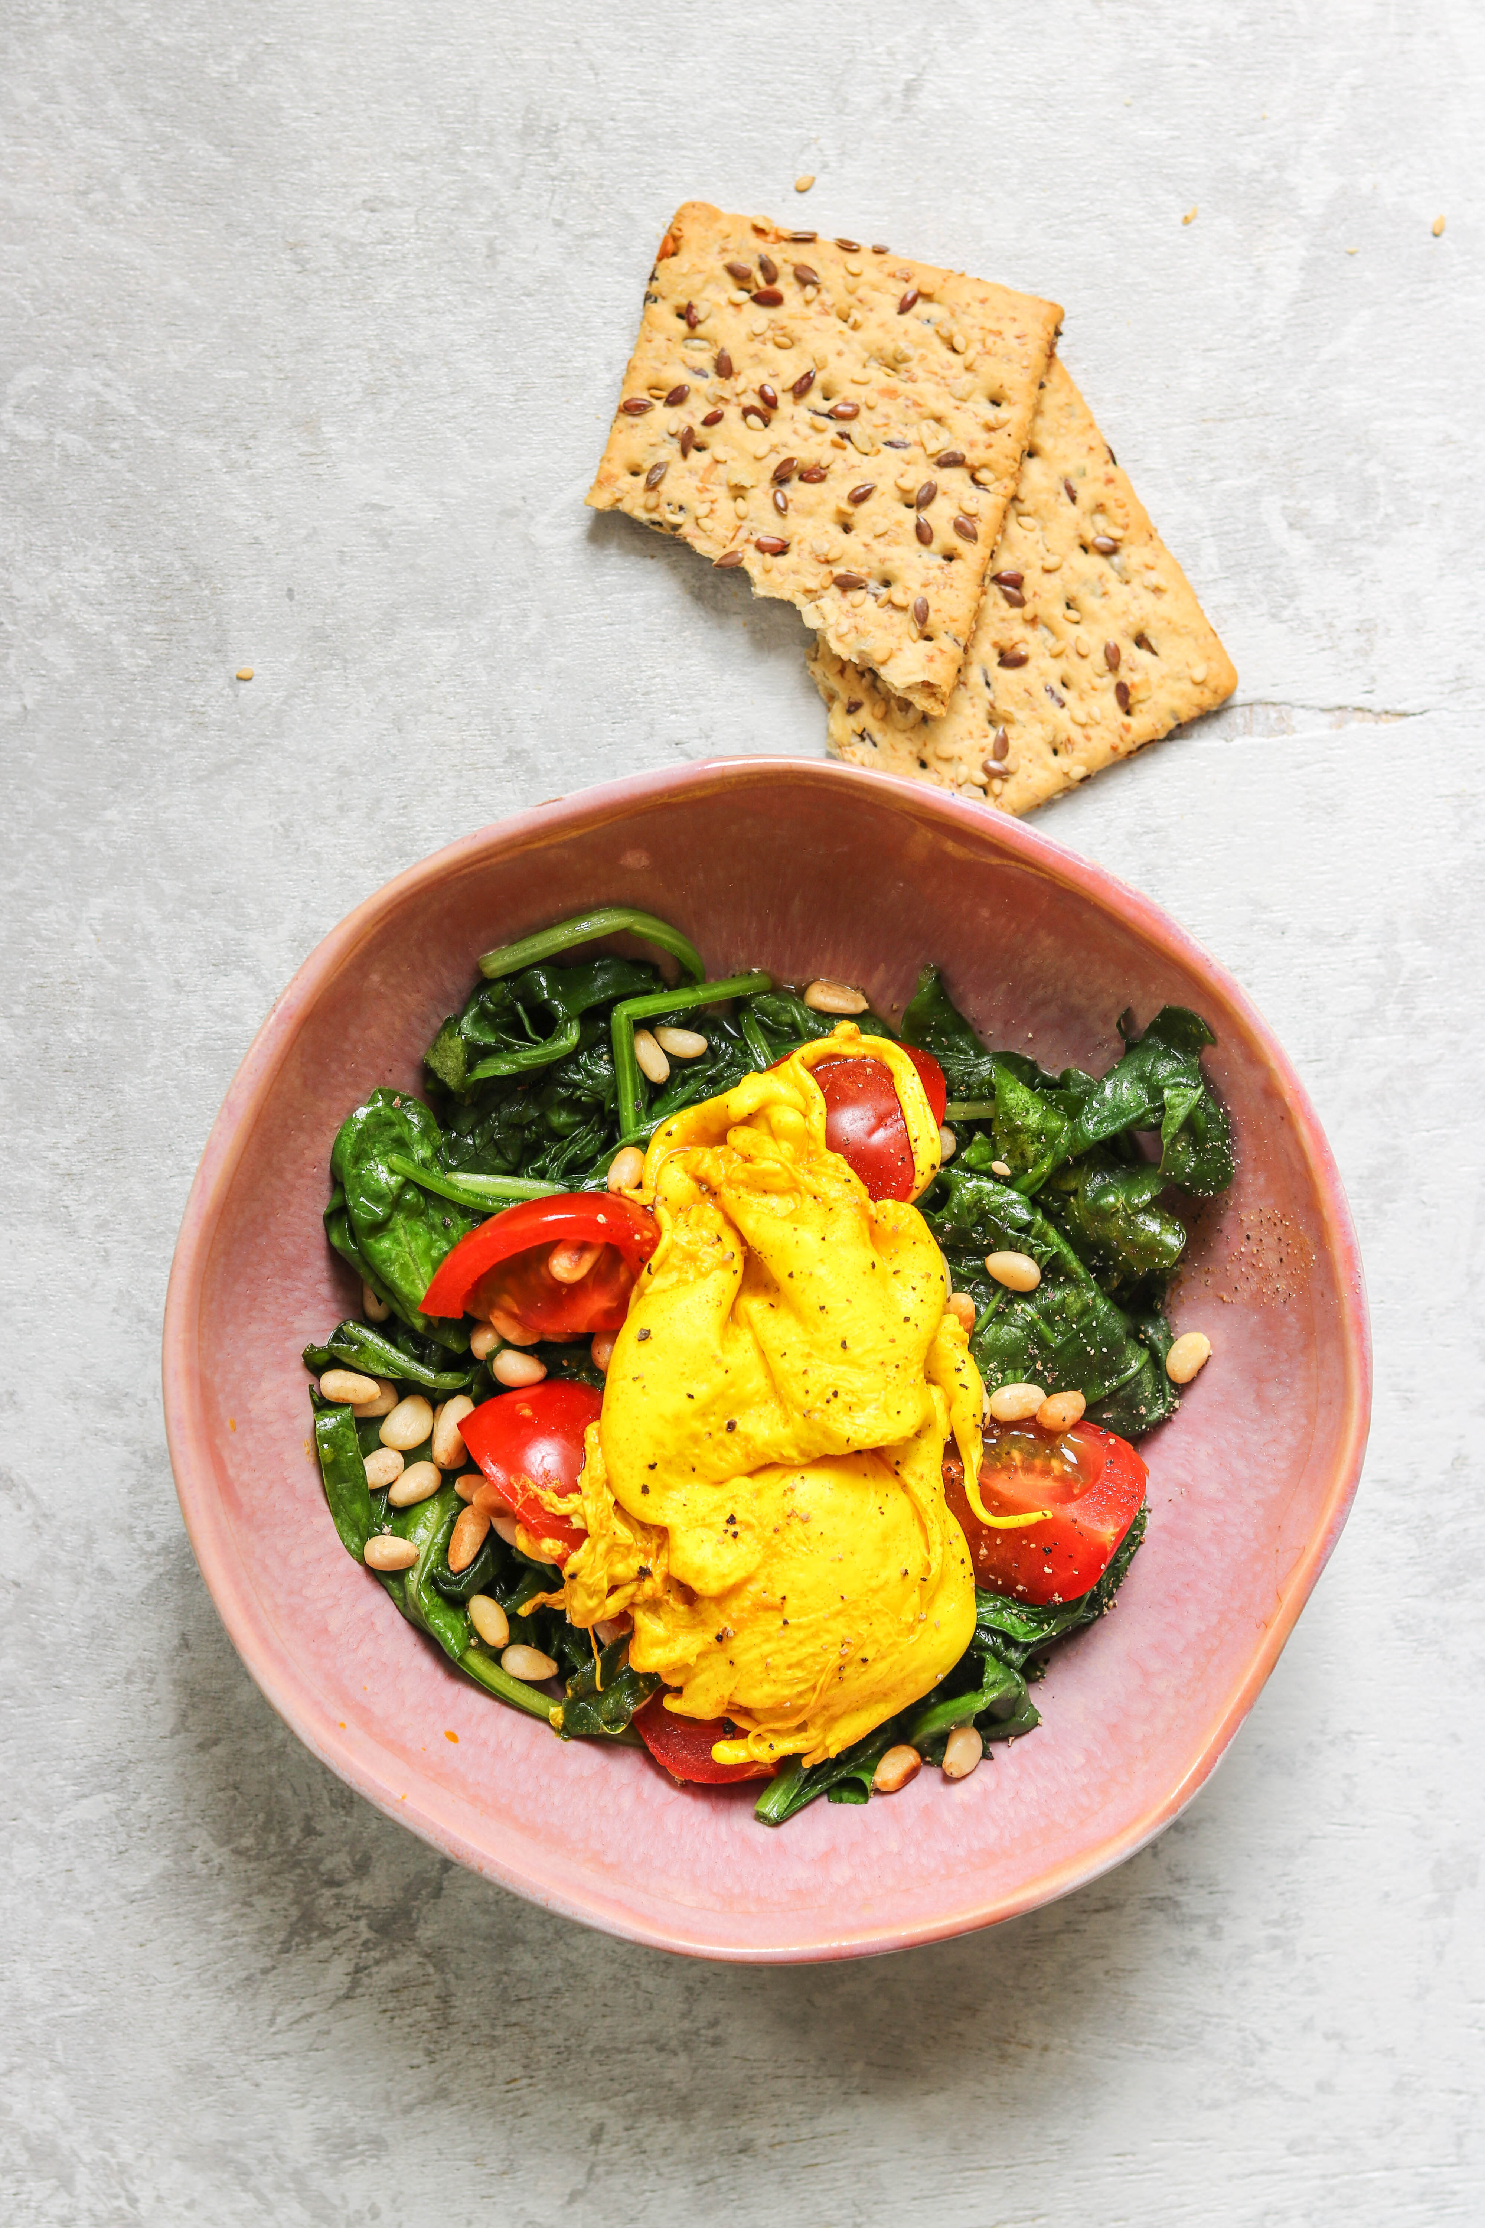
Turmeric Poached Egg
Serves 2
What you need to do
2 tsp. pine nuts
1 ¾ cups (400g) of fresh spinach
⅝ cup (125g) of tomatoes, halved
1 tbsp. mild olive oil
1 tbsp. white wine vinegar
1 tsp. ground turmeric
2 medium-sized eggs
Heat a dry frying pan and toast the pine nuts for 2 minutes, then set aside.
In the meantime, heat the oil in a frying pan and stir fry the spinach and tomatoes for 2 minutes on medium heat until wilted. Season with salt and pepper.
Bring a pot of water to the boil and add in the vinegar and turmeric. Turn the heat down so that the water no longer bubbles. Carefully break in the egg and poach for 3 minutes repeat with the second egg.
Divide the spinach over two bowls, top with the poached egg and sprinkle with toasted pine nuts. Season with salt and pepper. Break open the eggs just before serving.
Prep | Cook | Kcal | Fats(g) | Carbs(g) | Protein(g)
10 mins | 5 mins | 219 | 15 | 12 | 14
Sarahmaxwell.com

Slide 3
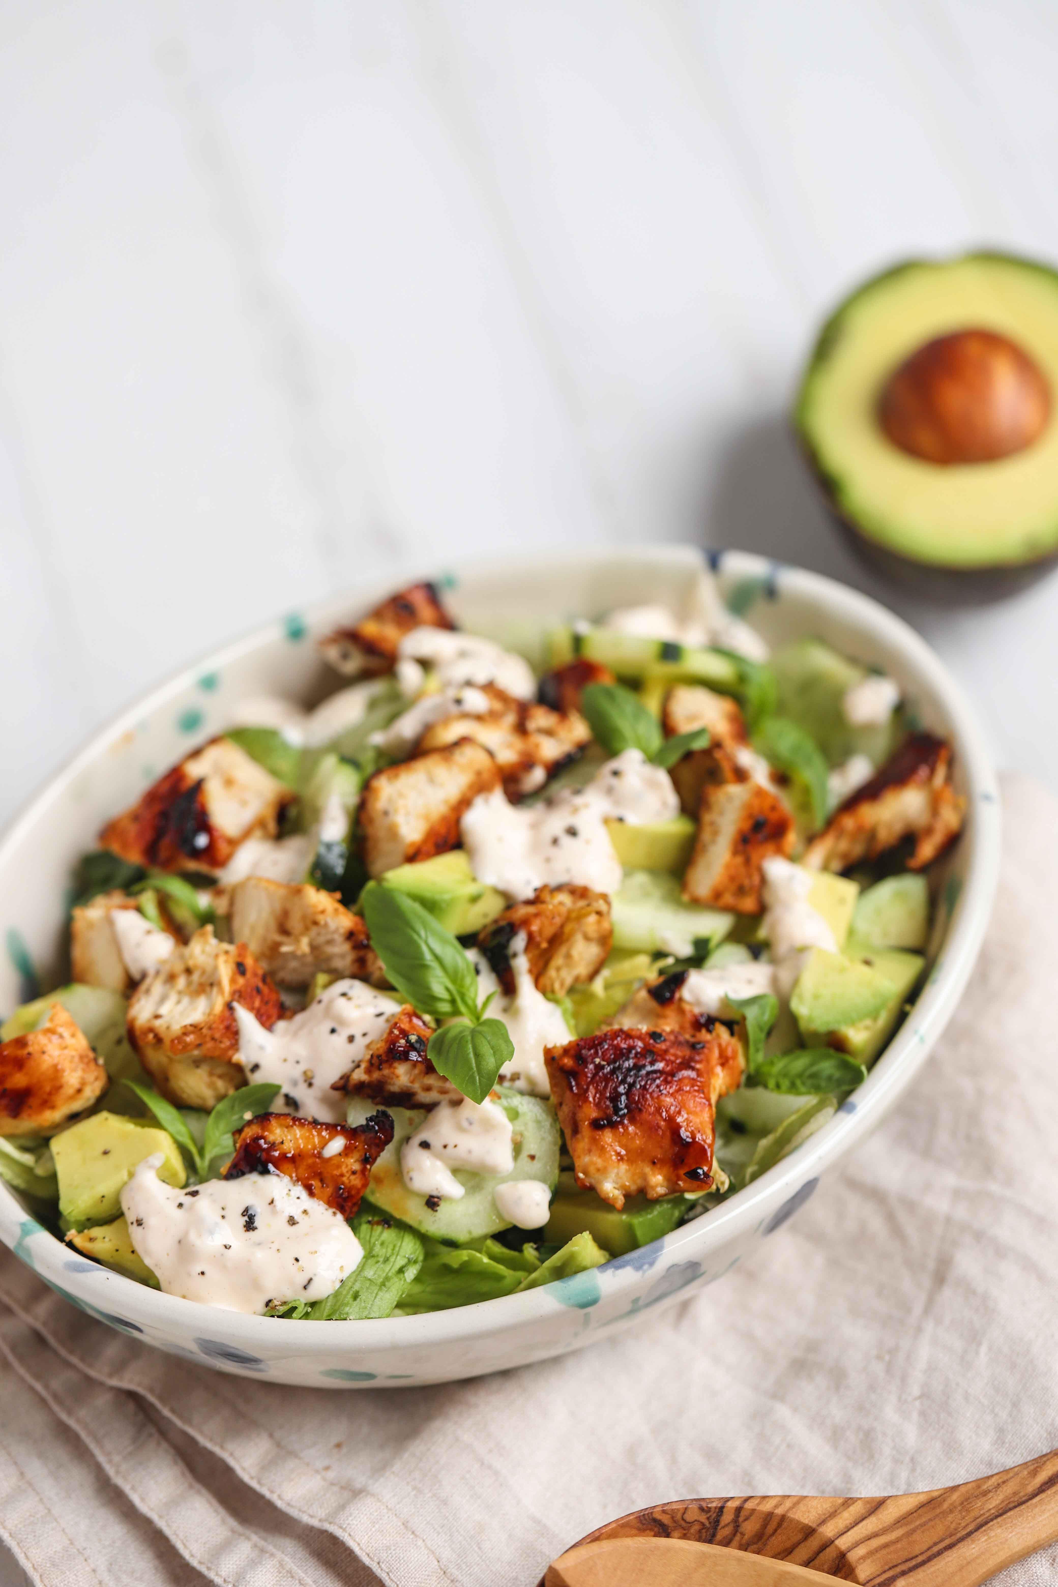
Cucumber, Avocado & Chicken Salad
Serves 4
What you need to do
For the salad:
½ head iceberg lettuce, shredded
a dozen basil leaves, torn
1 avocado
2 tsp. lemon juice
½ cucumber, peeled
¼ cup (25g) walnuts
For the chicken:
2 chicken breast fillets (around 150g each)
1 tbsp. olive oil
1 tbsp. mustard
1 tbsp. honey
For the sauce:
3 tbsp. yogurt
1 tbsp. mayo
1 garlic clove, minced
Place the iceberg lettuce into a large bowl. Add torn basil leaves and mix. Divide between 2 serving bowls.
Season the chicken fillets with salt and rub with olive oil. Heat a dry pan and fry the chicken for 5 minutes on each side.
In the meantime, mix the mustard and honey. Grease the top of the fillets with half the sauce, then turn and cook for another 1.5 minutes. Repeat on the other side. Once cooked, cool slightly and chop.
Cut the avocado flesh into cubes, and drizzle with lemon juice. Peel and slice the cucumber.
Prepare the garlic sauce by mixing all the sauce ingredients — season with salt & pepper.
Top salads with the chopped chicken, avocado, cucumber, and walnuts. Pour over the garlic sauce, and serve.
Prep | Cook | Kcal | Fats(g) | Carbs(g) | Protein(g)
10 mins | 15 mins | 304 | 20 | 12 | 21
Sarahmaxwell.com

Slide 4
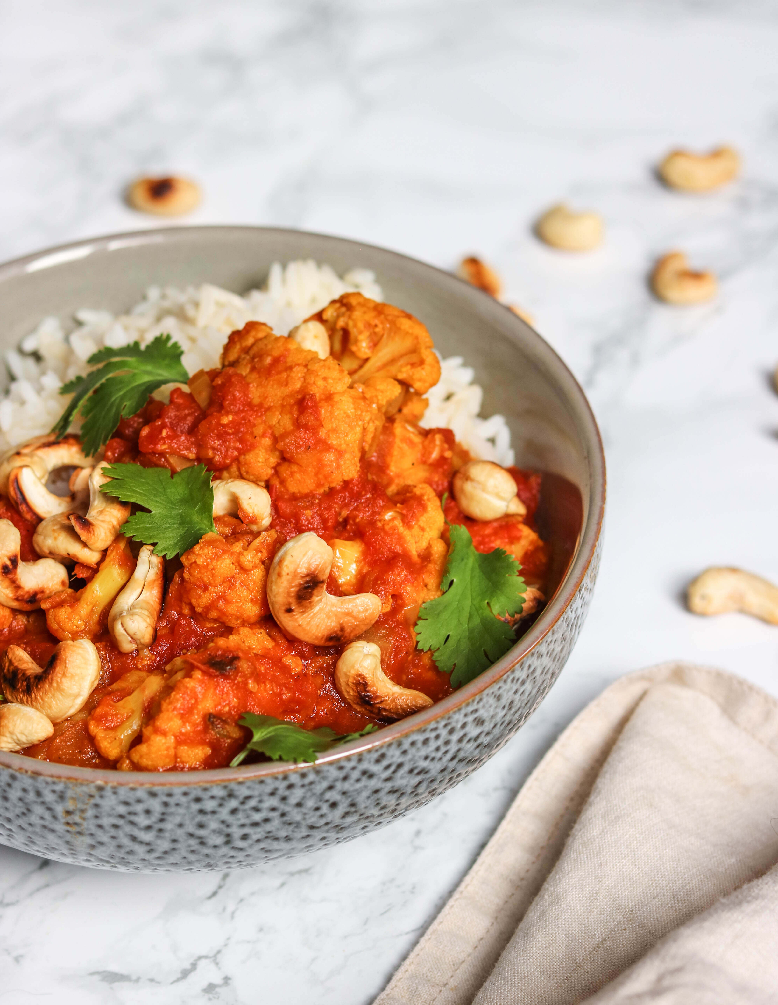
Slow Cooker Cauliflower Tikka Masala
Serves 4
What you need to do
1 tbsp. coconut oil
1 small cauliflower head, cut into florets (about 4 cups florets)
1 medium onion, diced
3 cloves garlic, crushed
1 tbsp. ginger, grated
3 tbsp. curry powder
3 ½ cups (800g) can diced tomatoes with their juice (about 3 cups)
1 tbsp. honey
½ cup (120ml) full-fat coconut milk (canned)
handful fresh parsley
⅓ cup (50g) cashews roasted
Add the coconut oil, cauliflower, onion, garlic, ginger, curry powder to the slow cooker. Season with salt and pepper.
Pour in the diced tomatoes and honey stir to mix everything.
Cook on high for about 3-4 hours or the cauliflower is tender.
Add the coconut milk, and stir well. Cook for another 3-5 minutes on low until warmed through.
Serve topped with chopped coriander and roasted cashews, accompanied by rice (not included in nutrition info).
Prep | Cook | Kcal | Fats(g) | Carbs(g) | Protein(g)
10 mins | 3-4 hrs | 226 | 14 | 22 | 7
Sarahmaxwell.com

